Slide 1
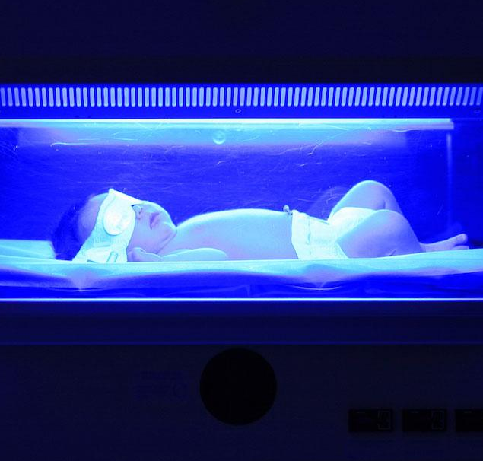
NEONATAL
HYPERTHERMIA
Presentees : Kreety Khatri 2K19/EP/045
Pulkit Pandey 2K19/EP/076

Slide 2
ACKNOWLEDGEMENT
Presentation, Inspiration and Motivation have always played a key role in success of any project.
We express our deep sense of gratitude to Dr Ajeet Kumar, Assistant Professor, Department of Applied Physics, DTU to encourage us to highest peak and to provide with the opportunity to prepare the project. We are immensely obliged to her for her elevating inspiration, encouraging guidance and kind supervision in the completion of the project. We are also thankful for her invaluable constructive criticism and advice throughout the working of the project.
The accomplishment of the project was due to our equal efforts and contribution.
.

Slide 3
TABLE OF CONTENTS
1
2
3
4
Project Overview
Biological Intra-Part
Objective
Proposed Idea
HyperBilirubinemia
Neonatal Hyperthermia
Mathematical Model
Simulation & Results
Physical System
Bio-Heat Equation
Finite Volume Method
Matlab Graph Plot

Slide 4
OBJECTIVE

Slide 5
“ The core objective of fabricating this project was to apply the concepts of Computational Methods in such a way that it impacts the betterment of Human-Life directly ”

Slide 6
BIOLOGICAL
INTRA-PART
Notes:
ADD VISUAL PERSPECTIVE SLIDE

Slide 7

VISUAL PERSPECTIVE
1

Slide 8
2
HYPERBILIRUBINEMIA

Slide 9
OCCURRENCE
60%
100%
16%
ALL-TERM
PRE-TERM
SEVERE-CASES

Slide 10
NATURAL ERADICATION
Unconjugated 4Z,15Z-bilirubin
LIVER
( Blood Vessels )
Glucuronic Acid

Slide 11
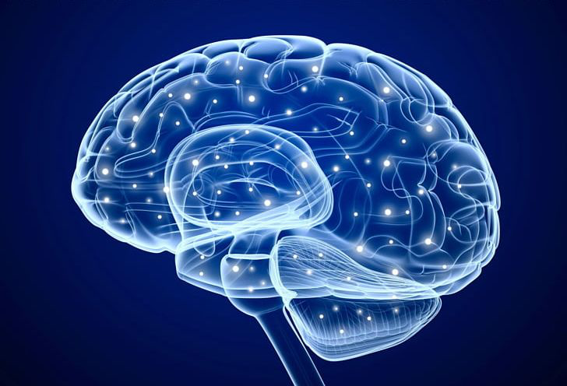
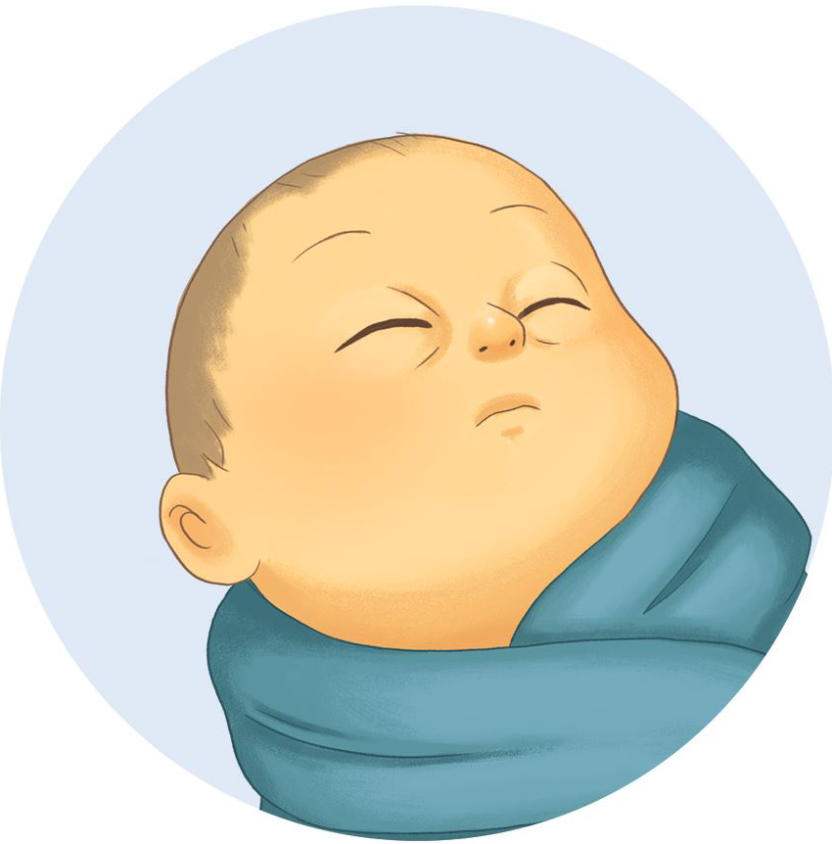
IMPLICATIONS
KERNICTERUS
SEVERE JAUNDICE
Severe issues in the CNS e.g -- Brain Lesions.

Slide 12
3
TREATMENT

Slide 13
PHOTOTHERAPY
The use of visible light for the treatment of hyperbilirubinemia in the newborn.
Therapy lowers the serum bilirubin level by transforming bilirubin into water-soluble isomers .
Notes:
Add Video instead of picture ; 23 - 51.
Link : https://www.youtube.com/watch?v=2Qz5Oof52Cs

Slide 14
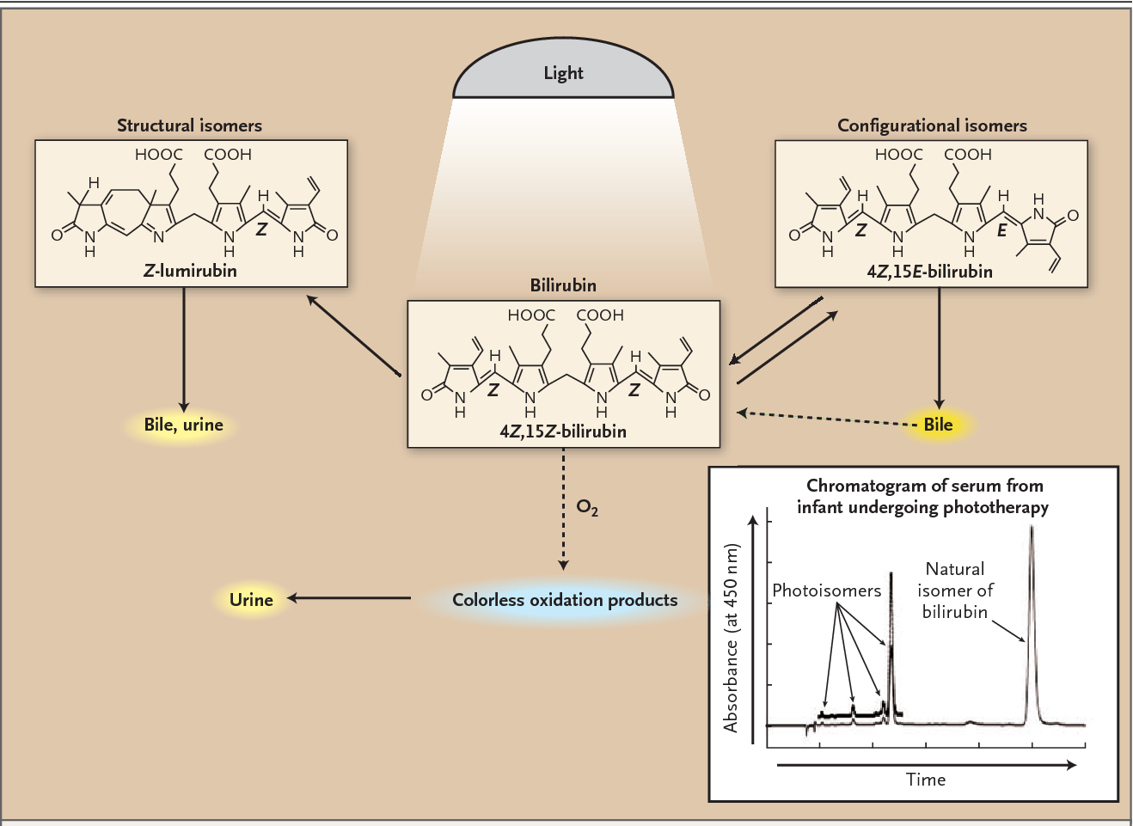
FUNDAMENTALS OF BLUE LIGHT PHOTOTHERAPY

Slide 15
4
HYPERTHERMIA

Slide 16
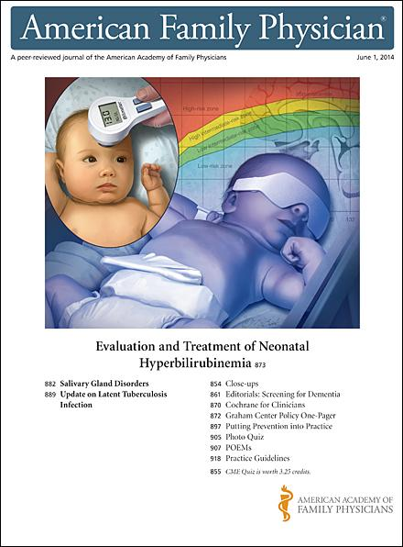
IMPLICATION OF PHOTOTHERAPY
Absorption of light heats the patient.
Clinical complication of phototherapy is “bronze baby syndrome,” a grayish-brown discoloration of the skin that occurs exclusively in infants with cholestatic jaundice.

Slide 17
PROPOSED IDEA

Slide 18
“ To develop a Real-Time Monitoring System in order to prevent Hyperthermia caused due to Intensive Blue Light Phototherapy by using Computational Methods. ”

Slide 19
MATHEMATICAL
MODEL

Slide 20
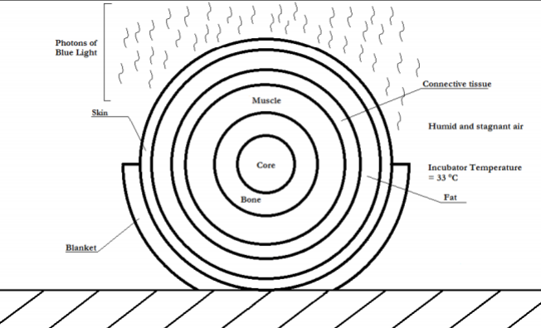
NEONATE
GEOMETRY

Slide 21
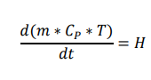
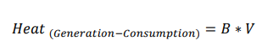
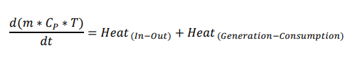
GENERAL MODEL DEVELOPMENT
Energy Balance Equation derived from the First Law of Thermodynamics.

Slide 22
GENERAL MODEL DEVELOPMENT
“It is the transfer of heat to the air surrounding the skin. The warmed air rises away from the body and is replaced by cooler air that is subsequently heated.
”
“ It is the transfer of heat via infrared waves. This occurs between any two objects when their temperatures differ.”
“It is the transfer of heat by two objects that are in direct contact with one another. It occurs when the skin comes in contact with a cold or warm object. “
”
CONVECTION
CONDUCTION
RADIATION

Slide 23
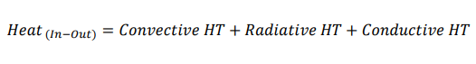
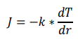
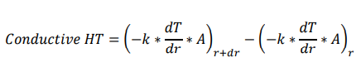
GENERAL MODEL DEVELOPMENT
Heat enters and leaves the shell via convective, radiative and conductive heat transfer.

Slide 24
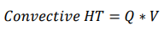
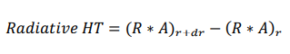
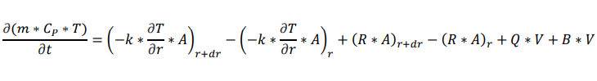
GENERAL MODEL DEVELOPMENT
Q and R are the functions of Surface Area of the system assumed.

Slide 25
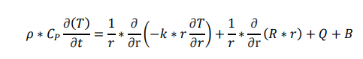
GENERAL MODEL DEVELOPMENT
The difference in conductive and radiative heat transfer at the inner and outer surface of the shell is re-written in differential form, recognizing that dr is infinitesimally small.
Therefore, the equation below represents the derived Bio-Heat Equation, which can be generalized to the entire simplified body.

Slide 26
MODEL SOLUTION

Slide 27
FINITE
VOLUME METHOD

Slide 28
DOMAIN MODELLING
EQUATION DISCRETISATION
DERIVED SYSTEM OF ALGEBRAIC EQUATION
DOMAIN DISCRETISATION
APPLICATION OF FVM

Slide 29
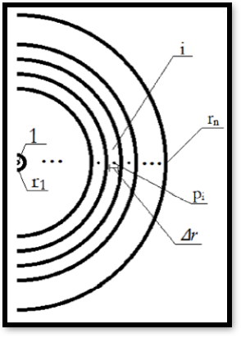
FINITE
VOLUME METHOD

Slide 30
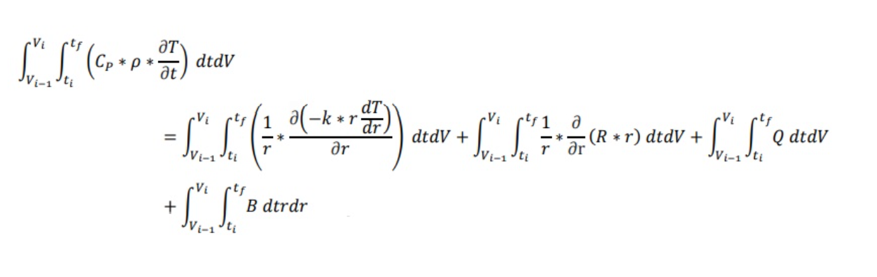
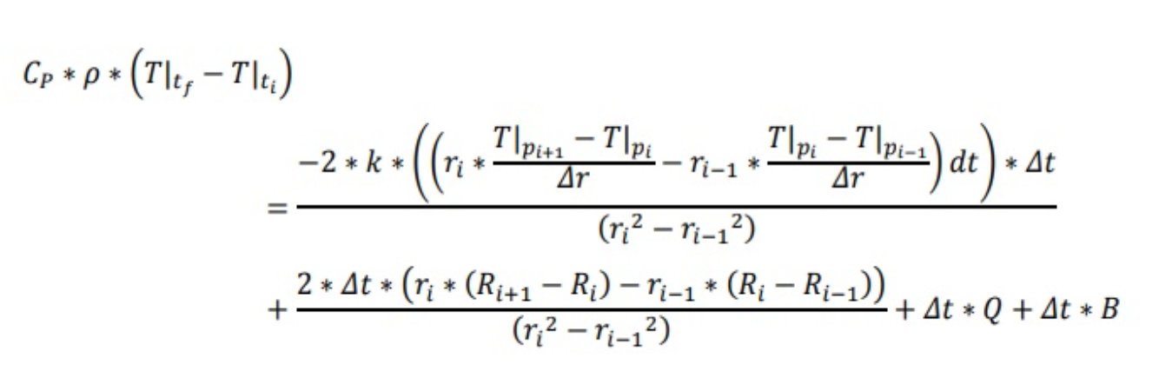
FINITE VOLUME METHOD

Slide 31
SIMULATION RESULTS

Slide 32
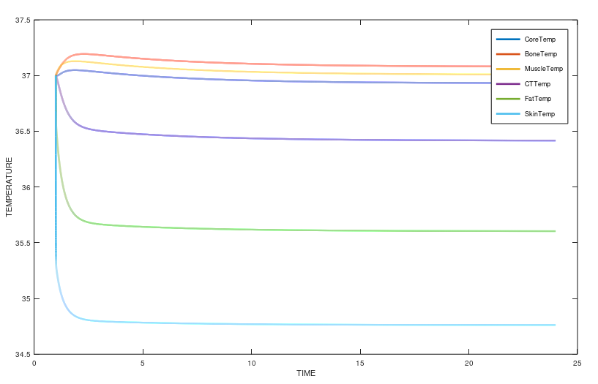
SIMULATION RESULTS : GRAPH PLOT

Slide 33
THE END

